Slide 1
Vectors , Matrices, and Arrays in Python

Slide 2
Course outline
Evaluate vectors, matrices, and arrays in Python (Module: numpy)
Use Python modules to work with vectors
Use Python modules to work with matrices
Use Python modules to interact with elements of matrices
Use Python modules to interact with elements of arrays
Use Python modules to reshape arrays

Slide 3

Contents
Python modules to work with vectors
Python modules to work with matrices
Python modules to interact with elements of matrices
Python modules to interact with elements of arrays
Python modules to reshape arrays

Slide 4
NumPy Module
NumPy stands for Numeric Python. It is a Python Package which helps in computing and processing of the multidimensional and single dimensional array elements.
NumPy is very fast which is a major factor that justifies it’s use with large data sets.
The only prerequisite for installing NumPy is Python itself. Since, for example certain Distributions like Anaconda comes with NumPy and other commonly used packages.
Apart from that if you want to explicitly install NumPy you can always use pip command
Pip install NumPy

Slide 5
Using numPy Library
Check if numPy is present, if not use the following command
pip install NumPy
2. Next step, import NumPy
Import NumPy
3. You can also use alias while importing as
Import NumPy as np

Slide 6
Vectors in Python
A vector is nothing but a single dimensional array. It contains homogenous elements.
Simply put, we can think of vector as a list of numbers. They are single one-dimensional array of lists and behaves similar to a python list except for the fact that they are much more efficient and faster when dealing with large data.
A vector can be horizontal as well as vertical.
We use numPy to create python vectors.

Slide 7
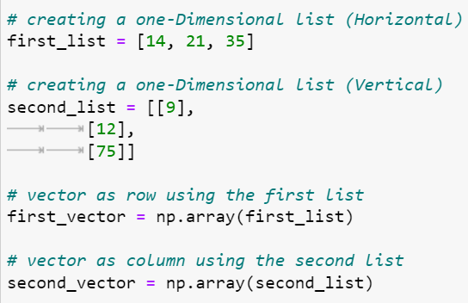
Creating a vector in Python
The standard way of creating a vector in python
is by using np.array method
Syntax: np.array(list) Argument : It take 1-D list it can be 1 row and
n columns or n rows and 1 column Return : It returns vector which is numpy.ndarray

Slide 8
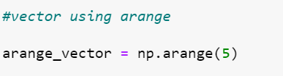
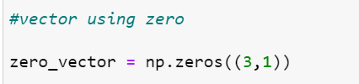
Other ways of creating a vector
Though the preffered way of creating a vector is by using np.array, we can also use alternate methods.
To create number sequences we can us arange method of numPy which is tantamount to python built-in range but instead returns an array.
Zeros create an array of zeroes, ones create an array full on 1’s and empty creates random content depending on the initial memory. The default datatype of created array will be float.

Slide 9




Basic Arithmetic operations on Vectors
We can perform various arithmetic operations on vectors. They are:
Addition:
Subtraction:
Multiplication:
Division:

Slide 10

Other Arithmetic operations on Vectors
Dot Product:
Scalar Multiplications:

Slide 11
NumPy Arrays
An array is a homogenous collection of elements, which means all the elements are of same type which are usually numbers.
NumPy’s array class is called ndarray.
In a numPy array the dimensions are usually called or referred to as axes.
These arrays are as usual indexed using non negative integers.

Slide 12

Creating an array and basics
Vectors are one dimensional arrays, but an array can be beyond a single dimension that can be created as shown below.
Arrays basically transforms the given sequences in two dimensional, three dimensional and so on according to how we define the array.

Slide 13


Depending on the data types of the elements in an array explicit typecasting occurs

Slide 14
Few Important attributes/methods of an array
1.ndarray.ndim: The number of dimensions/axes of an array
2.ndarray.size: The total number of elements in an array.
3.ndarray.itemsize: The size of a each element (i.e of a datatype)
4.ndarray.shape: The number of rows and columns
5.ndarray.dtype: The datatype of the elements present

Slide 15
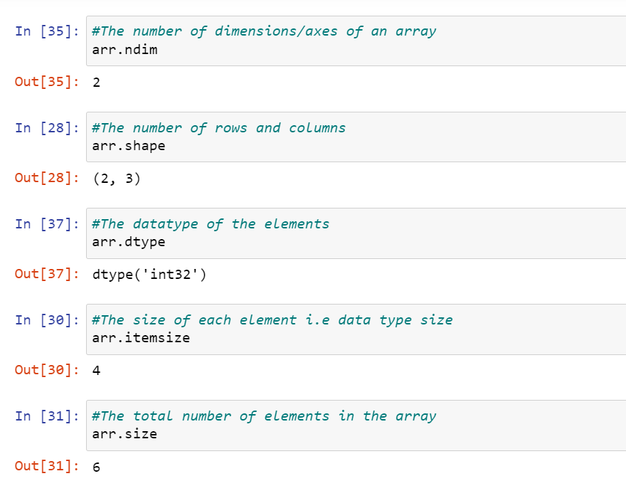
These can be mentioned as attributes while creating an array or called individually as methods.

Slide 16
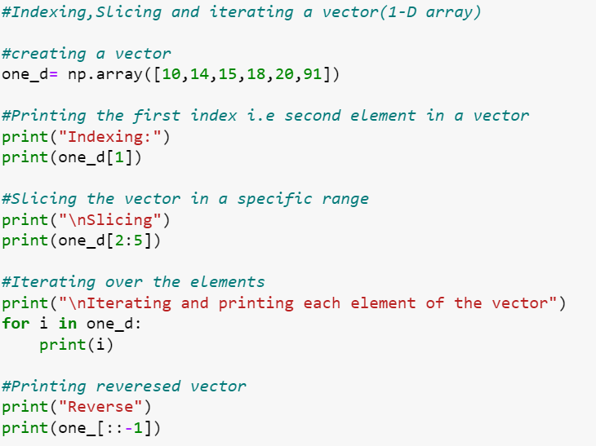
Interacting with the arrays - Vectors
We can slice and index one dimensional arrays that is vectors similar to the lists:

Slide 17
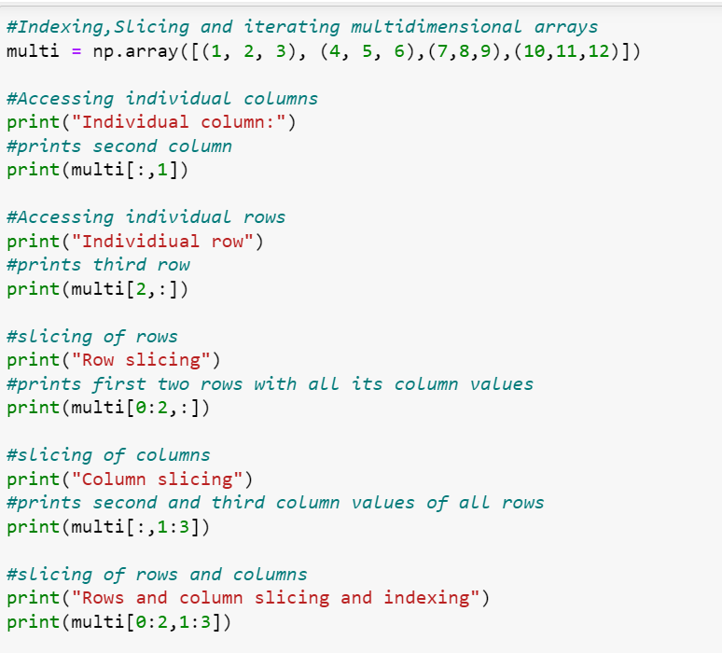
Interacting with the arrays - Multidimensional
Indexing and slicing with multidimensional arrays is a little tricky as there are various rows and columns.

Slide 18
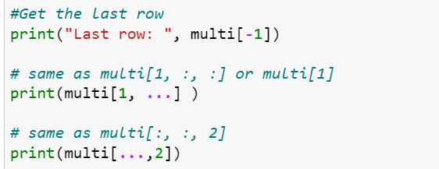
Interacting with the arrays - Multidimensional
Further interaction
Iteration is similar to one dimensional arrays.
All universal functions are supported by these arrays
Example: np.sqrt(arr), np.exp(arr)

Slide 19
Matrices in Python NumPy
A Python matrix is a specialized two-dimensional rectangular array of data stored in rows and columns. The data in a matrix can be numbers, strings, expressions, symbols, etc.
Matrix is a quintessential data structure that can be used in scientific and mathematical calculations.
Its specialty is that it retains its two dimensional structure no matter any operation.
It also has special and specific operators like * which is matrix multiplication and ** which is matrix power

Slide 20
Creating a Matrix using NumPy
numpy.matrix() is used to create a special two-dimensional array
Syntax: numpy.matrix(data,dtype= datatype,copy=true/false)
Arguments:
data- the data is the element values we are giving, should be array-like or even a string
Dtype- this should be the datatype of the array that is being returned
Copy- if data is already a ndarray, then this bool value determines if data is copied or a view is created. By default it is copied
Return: Returns the intended matrix

Slide 21
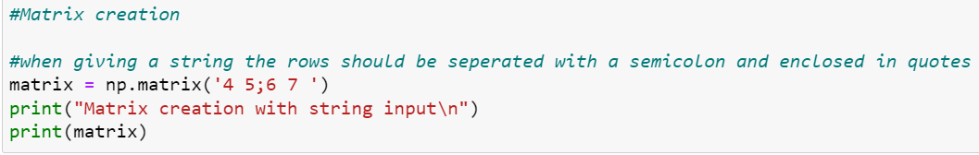
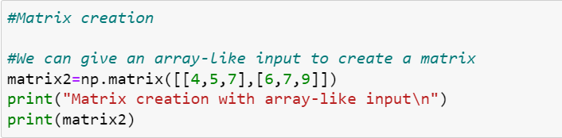
Example of Matrix creation

Slide 22
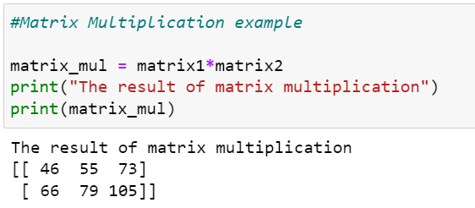
Using special matrix operators
Unlike the element by element multiplication that has been observed in arrays, in matrix ‘*’ operator performs the actual matrix multiplication.

Slide 23
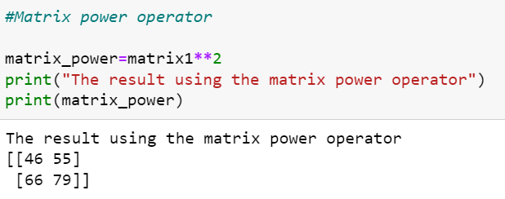
Using matrix special operators
The second special operator is ‘**’ which results the power of a matrix where the exponent should be an integer

Slide 24
Few important points on matrices
Every matrix supports the basic four arithamatic operations that are supported by the arrays and are accessed similarly.
The slicing,indexing and iterating is also similar to the multi dimensional array’s except for the fact that it is a two dimensional array in the case of a matrix.
A matrix can be created using the arrays mentioned previously mentioned by making sure that it is two dimensional

Slide 25
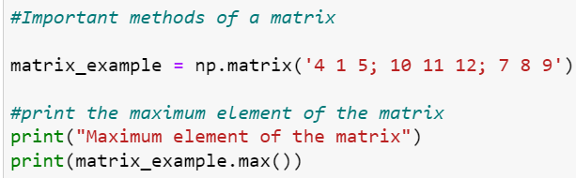
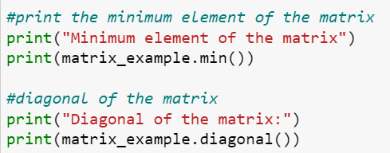
Important methods in a matrix
1.max([axis,out]): Returns the maximum value along the given axis
2. min([axis,out]): Returns the minimum value along the given axis
3. diagonal([offset,axis1,axis2]): Returns the diagonals specified

Slide 26
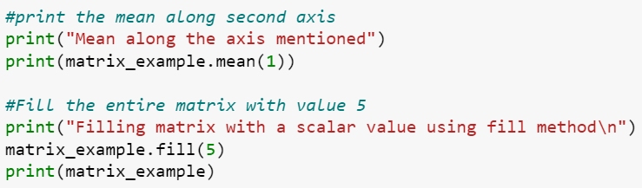
4. fill(value) : Fill the matrix with the scalar value mentioned.
5. mean([axis,dtype,out]) : Returns the mean of the elements in matrix along the mentioned axis

Slide 27
Using the Reshape Method
The reshape method in numPy is usually used to change the shape of the array without changing the data present in it.
Syntax: numpy.reshape(array,shape,order = ‘ ‘ )
Arguments: array- The array you want to reshape
Shape- int or tuples of int
Order- C,F,A
Return: Returns the reshaped array without modifying the data

Slide 28
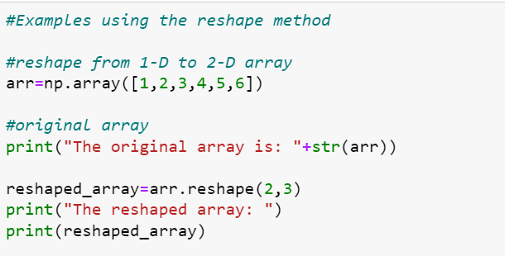

Examples using reshape
Reshape
2. Flattening the array by passing the -1 as argument to the reshape method

Slide 29
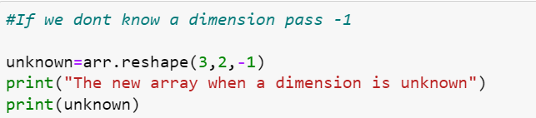
Examples using reshape
If any dimension is unknown pass -1 in its place. But, we can pass only one -1 not more than that.

Slide 30
Assignment
Create an array using numPy and perform the following operations on it
Create a one dimensional array (vector) iterate through all the elements and find the mean of the vector.
Create a 3X3 array and find the sum of all elements in the second column
Create array using other standard methods like ones and empty by taking the zeros as reference
2. Create a matrix and perform the below operations on it
Get the diagonal elements and calculate the sum of all the diagonal elements.
Calculate the column wise and row wise mean of the created matrix
3. Can we reshape the array into any shape? If not, then what are the cases?
4. Use arange and create a sequence of 6 numbers and try to reshape into all the possible ways and combinations

Slide 31
Summary

Slide 32
Q&A

Slide 33
References
https://numpy.org/doc/stable/user/quickstart.html
https://www.youtube.com/watch?v=8JfDAm9y_7s
https://www.w3schools.com/python/numpy/numpy_array_reshape.asp

